Slide 1
Opening of Schools Elementary/Secondary 2013-14 August 27, 2013
Board of Education
Charles McCully, Interim Superintendent
Dawn Miller, Assistant Superintendent, Secondary Education
Doreen Lohnes, Assistant Superintendent, Support Services
Michelle Rodriguez, Ed.D., Chief Academic Officer

Slide 2
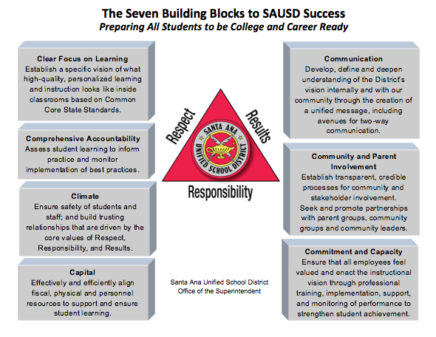
The Seven Cs and School Improvement
2
Notes:
Our Improvement Framework!
We start with 1) data analysis of each school site, and then 2) look at what each school is doing in each area together. From there, we develop specific plans to raise student achievement, and allocate resources accordingly.

Slide 3
Textbooks/Instructional Materials
Textbooks and instructional materials have been delivered to the sites. With Common Core instructional materials on the horizon, great effort was taken to minimize expenditures and to make maximum use of current inventories of textbooks and other instructional materials.
Principals have signed a verification form indicating that they have sufficient textbooks to meet the needs of the anticipated student enrollment.
Ed Services will monitor site needs and immediately process any late requests due to fluctuations in enrollment.
3

Slide 4
K-12 Master Schedules
The goal is to have 100 percent of currently enrolled students who show up on the first day completely scheduled and in class.
Counselor time on the first day of school will be devoted primarily to scheduling students new to the District.
4
Notes:
This slide sets up the lenses that are used to view intermediate school performance.
Most data is official CDE data.
Academic: Basically tests scores like CST, and CELDT, and accountability figures like the API. Also,
Climate: Suspensions and Expulsions
Please identify which data you want to use and which you do not.

Slide 5
Special Education Transportation
Transportation for approximately 1,500 Special Education students will be available on the first day of school.
The Support Services and Business Services Divisions are working closely together to ensure that the first day of school goes smoothly.
5
Notes:
This slide sets up the lenses that are used to view intermediate school performance.
Most data is official CDE data.
Academic: Basically tests scores like CST, and CELDT, and accountability figures like the API. Also,
Climate: Suspensions and Expulsions
Please identify which data you want to use and which you do not.

Slide 6
Staffing
Teachers have been assigned to classrooms/courses to ensure full staffing on the first day of school.
As of August 27, 2013, there are only six vacant teacher positions and four vacant A.P. positions. Subs are in place to cover these vacancies.
Human Resources has been consistently interviewing and hiring to fill vacant positions.
6

Slide 7
Enrollment Projections
Program Verification occurs at both the intermediate and high school levels. Program Verification for intermediate and high schools took place from August 6 to August 24.
Elementary enrollment has been verified via an Edulink phone call/survey and follow up parent contact.
Attendance projections will continue to be calculated as students enter and leave the District.
Business Services will continue to work with Human Resources to ensure that staffing is adjusted according to enrollment data.
7
Notes:
This slide sets up the lenses that are used to view intermediate school performance.
Most data is official CDE data.
Academic: Basically tests scores like CST, and CELDT, and accountability figures like the API. Also,
Climate: Suspensions and Expulsions
Please identify which data you want to use and which you do not.

Slide 8
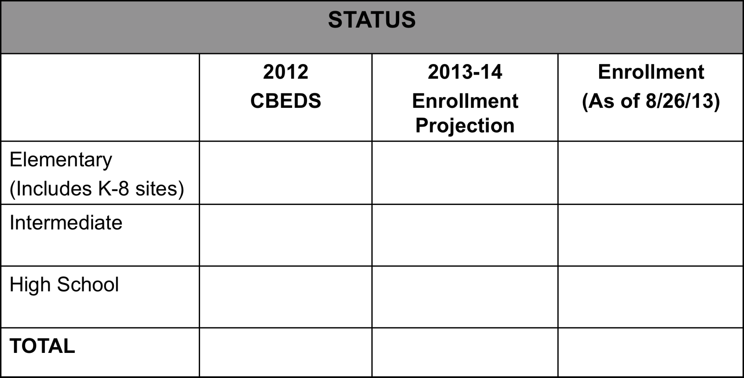
Enrollment Projections
Prior to Opening Day
27,041
27,637
27,783
11,224
11,189
11,159
15,131
15,093
14,547
53,496
53,371*
53,489
Budgeted Enrollment – Staffing Projections do not equal budgeted projection
8

Slide 9
Facilities/ Maintenance
The Facilities and Maintenance Departments have ensured that classrooms have the necessary tables and chairs, schools have functioning air conditioners, school grounds are clean, and construction is complete prior to the first day of school.
Special attention has been given to schools transitioning to a K-8 configuration.
Specific construction projects will be substantially completed at Diamond, Garfield, Greenville, Heninger, Lathrop, and Spurgeon by the opening of the school year.
9

Slide 10
Opening Day Support
Sites will have key District personnel visiting sites and on-call via phone to handle all first day issues in real time.
10

Slide 11
Commitment to Success!
As a result of constant communication with principals and a commitment to providing any needed support, we anticipate a smooth opening to the 2013-14 school year.
11

